Slide 1

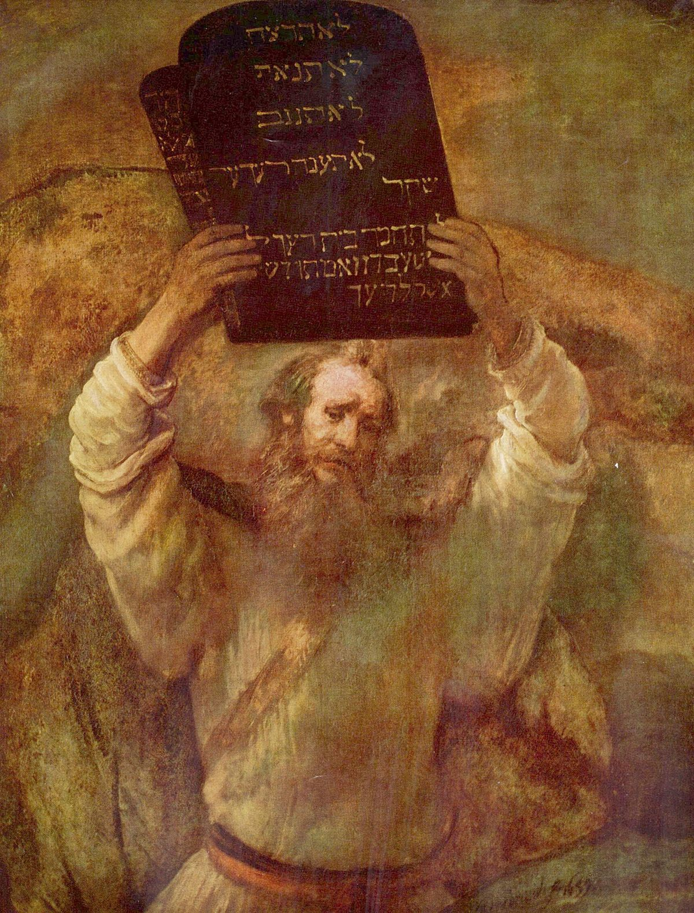
Judaism
According to the most recent research, there are about 15.8 million Jewish people alive, which comprises less than .2% of the world population. Why spend a full lesson on this seemingly small ancient religion?

Slide 2
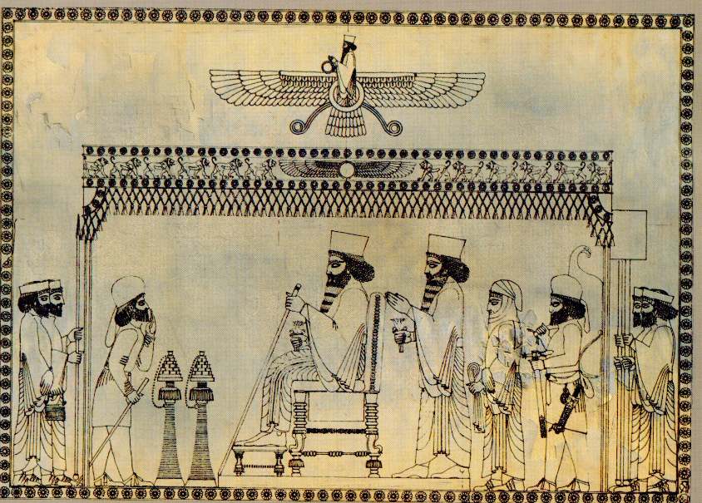
Aim: What factors allowed the Achaemenid Dynasty (Persia) to construct the world’s largest classical empire?
Please respond to the following question:
Do Now: Thought Bubble Activity
What characteristics are associated with a unified empire?
Announcements:
Pgs.158-166 Textbook Outline 14 bullet points in your notebook due 11/12.

Slide 3
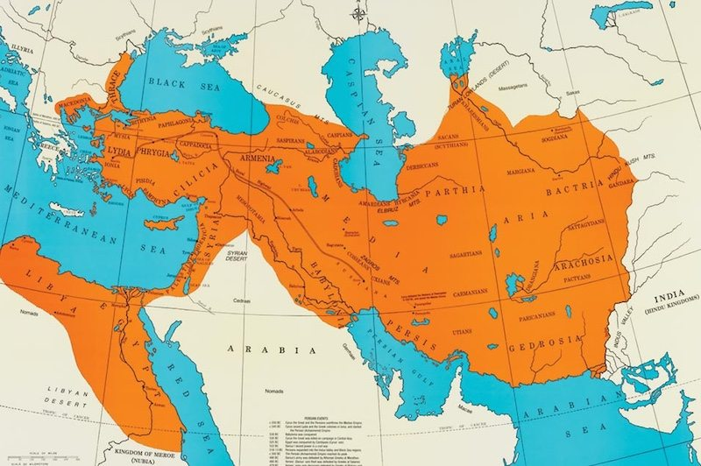

Slide 4
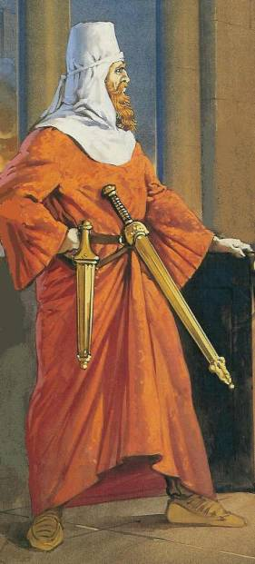
Cyrus the Great
Aim: What factors allowed the Achaemenid Dynasty (Persia) to construct the world’s largest classical empire?
Achaemenid Empire (550- 330 BCE)
550 BC – Conquered several neighboring kingdoms. Builds the largest empire in the world.
Military strategist – use of horse back and archery.
Captured and controlled an empire spanning 2000 miles (Indus River to Anatolia)
Kindness toward conquered people- His generals were told not to loot and burn down conquered cities.
Honored local customs and religions
538 BC - Allowed the Jews to return to their homeland, Jerusalem.
“This is the word of Cyrus king of Persia: The Lord, God of heaven has given me all the kingdoms of the earth, and he himself has charged me to build him a house at Jerusalem in Judah. To every man of his people now among you I say, God be with him, and let him go up to Jerusalem in Judah, and rebuild the house of the Lord God of Israel, the God whose city is Jerusalem.” Ezra 1:2-3 from the Tanakh
What type of ruler was Cyrus based on this quote?

Slide 5
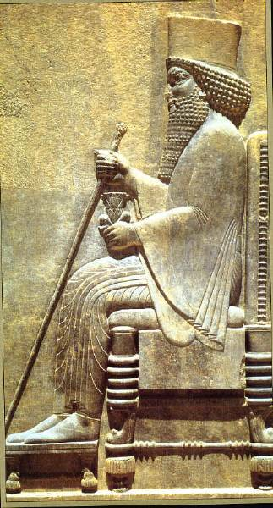
Darius I
Aim: What factors allowed the Achaemenid Dynasty (Persia) to construct the world’s largest classical empire?
Rules from 522-485 BCE and expands the empire to include the Indus Valley, Egypt, Macedonia and parts of Anatolia.
Divides empire into satrapies- local governors or satraps are appointed to take care of each tax region. An example of bureaucracy.
Excellent administrator- unifies the taxation system, standardized weights and measures and made Persian and Aramaic the two official writing systems of the empires
Expands and finishes the Royal Road.
Attempted to conquer Greece but was unsuccessful.
Funded the construction of Zoroastrian temples.

Slide 6
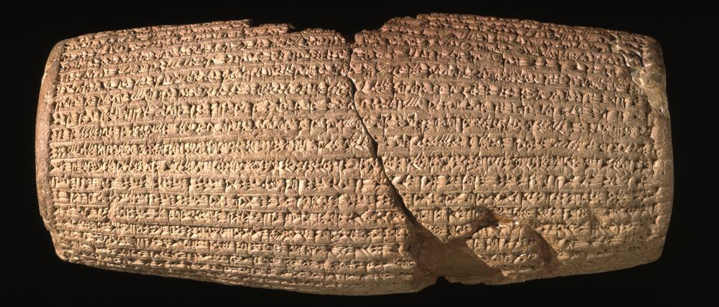
The Cyrus Cylinder 539 bce
A nine-inch-long piece of clay that is one of the most famous primary sources in the ancient world.
As Cyrus conquered new territories, he did not attempt to change their cultures but made offerings to local gods and allowed subjects to continue to worship as they had before.
Cyrus also facilitated the return of statues of local deities that had been removed by the Babylonians back to their original temples.

Slide 7
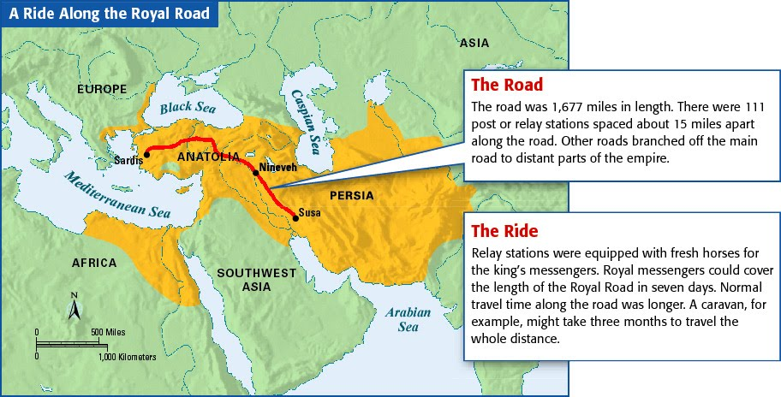
ADVANCEMENTS IN INFRASTRUCTURE
The Royal Road was an ancient highway built by the Persian king Darius the Great (Darius I) of the first Persian Empire in the 5th century BCE. Darius built the road to facilitate rapid communication throughout his very large empire from Susa to Sardis. The Greek historian Herodotus records the Royal Road as follows:
“The service (Messengers) is a Persian invention, and it goes like this, according to what I was told. Men and horses are stationed a day’s travel apart, a man and a horse for each of the days needed to cover the journey. These men neither snow nor rain nor heat nor gloom of night stay from the swiftest possible completion of their appointed stage.”

Slide 8
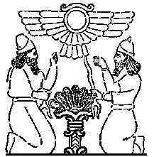
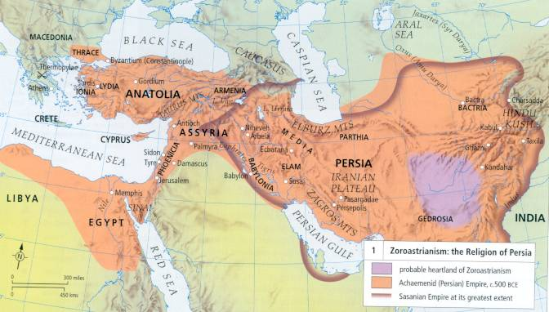
Zoroaster ~1000 BCE
Teachings of the Prophet Zoroaster are recorded in the Avestas, written sometime around 600 BCE.
Speaks of a supreme deity named Ahura Mazda. Promotes the dualistic belief in a Good and Evil spirit battling for control of the Earth.
All souls are judged and sent to paradise or to the fiery pit of hell.
Most Zoroastrian rituals involved fire altars.
Most households had personal fire altars that were fed five times a day during daily prayers.
Individual salvation possible through free will and choosing the goodness of truth.
Tried to answer age old question:
“Why should so much suffering
and chaos exist in the world?
Guiding Question: What connections can be made between Zoroastrianism and other religions we have learned about?

Slide 9
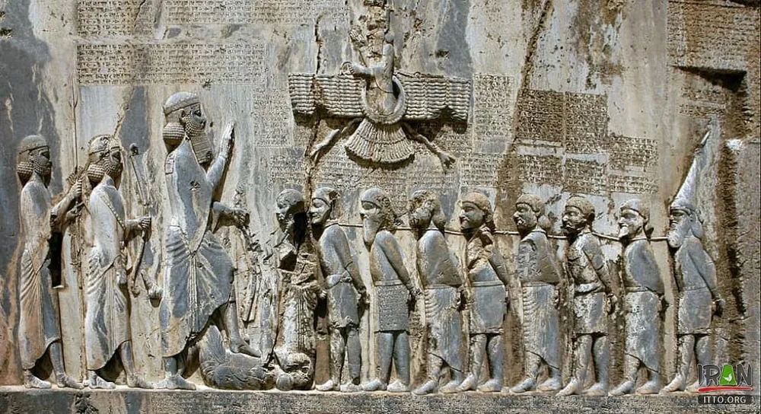
Ahura Mazda/ Zoroaster
God and Prophet
The most important mention of Ahura Mazda from this period is the Behistun Inscription written by Darius I around 516 BCE. The inscription accompanies a bas-relief depicting the victory of Darius over the pretender Gaumata, where the victor stands over his fallen and captured enemies. Above them hovers Ahura Mazda represented here as a king within a winged solar disc. The text of the inscription mentions how Ahura Mazda helped Darius defeat his enemy and that he, was chosen to lead his kingdom by the "grace of Ahura Mazda".

Slide 10
Excerpt from the Behistun Inscription
(53) King Darius says: These nine kings did I capture in these wars.
(54) King Darius says: As to these provinces which revolted, lies made them revolt, so that they deceived the people. Then Ahuramazda delivered them into my hand; and I did unto them according to my will.
(55) King Darius says: You who shall be king hereafter, protect yourself vigorously from lies; punish the liars well, if thus you shall think, 'May my country be secure!'
(56) King Darius says: This is what I have done, by the grace of Ahuramazda have I always acted. Whosoever shall read this inscription hereafter, let that which I have done be believed. You must not hold it to be lies.
(57) King Darius says: I call Ahuramazda to witness that is true and not lies; all of it have I done in a single year.
(58) King Darius says: By the grace of Ahuramazda I did much more, which is not graven in this inscription. On this account it has not been inscribed lest he who shall read this inscription hereafter should then hold that which has been done by me to be excessive and not believe it and takes it to be lies.

Slide 11
